Slide 1
AIDI 1010 – Introduction to Emerging Technologies WEEK2
Jahanzeb Abbas (JB)

Slide 2
Week Objectives
(A) Review of Python/Modules
Modules
BootCamp Video
(B) Review of Integrated Development Environment (IDE)
Local & Virtual
Introduction to Google Colaboratory (supported with video)
Setup
Access
Usage
(C) Review of Machine Learning
Supervised Learning
Unsupervised Learning
Reinforcement Learning

Slide 3

(A) Review of Python/Modules
Established 1991 -> Popular from 2005+
Python is an Interpreted Language:
Execute instructions without compiling a program (Java, JavaScript, C++, etc.)
Interpreter (Read one statement) vs Compiler (Read entire program)
“Python Interpreter” executes directly, translating each sequence of subroutines into a language for your machine; alternatives: Perl, Ruby, and others
Python also referred to as a “glue language” (Java, JavaScript, C++, etc.)
Python is critical for data science, machine learning, general software dev in academia/industry
Association with scikit-learn & pandas has made Python very popular against R, MATLAB, SAS, Stata, etc.
Runs slower than compiled language code but debugging is faster.

Slide 4
(A) Review of Python/Modules
Python Libraries
Collection of pre-written, compiled code defined to work with Python (Standard Library)
Existing compiled code that can be imported into Python (Modules, Modular Components)
Packaged into archives (which has metadata, other parameters)
NumPy: Numerical computing BFF for Python (Library)
Pandas: Data Manipulator BFF for Python (Library)
Matplotlib: Plots BFF for Python (Library)
SciPy: Scientific computing BFF for Python (Library)
Scikit-Learn: Machine Learning toolkit BFF for Python (Library)
Statsmodels: All things stats BFF for Python (Library)

Slide 5
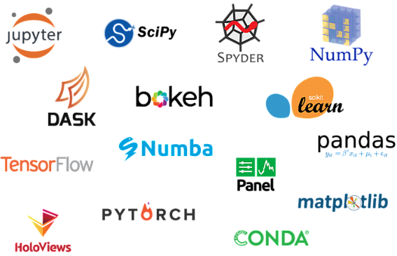
(A) Review of Python/Modules

Slide 6

(A) Review of Python/Modules
Check this excellent BootCamp video by Mike Dane (from freeCodeCamp.org) on introduction with Python syntax.
https://youtu.be/rfscVS0vtbw

Slide 7



(B) Review of IDE (Local)
Anaconda
Anaconda is a distribution of the Python and R programming languages for scientific computing, that aims to simplify package management and deployment.
https://www.anaconda.com/distribution/
IPython
“Interactive Python” is an interactive shell to run Python commands.
<ENTER> key executes the code.
Great for prototyping your code
Install through Anaconda
Have to install dependencies and modules separately
Jupyter Notebook
Web-based interactive shell to run Python commands. (IPython is the shell and kernel for Jupyter)
Code is produced when its run and ‘markdown cells’ are used to explain what the code means
Markdown is a popular language, superset of HTML
Install through Anaconda
Have to import libraries/modules separately

Slide 8

(B) Review of IDE (Virtual)
Google Colab
Check WEEK2’s video that can help you step through Google Colab
This will be the preferred IDE for the course
Web-based interactive shell to run Python commands
Architecture of Jupyter notebooks hosted on Google machines!
https://colab.research.google.com/
Next slide to guide you further
No messy installations; required packages already installed/imported
Run this code to check installed packages: !pip list -v

Slide 9

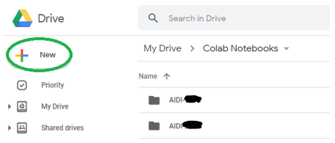
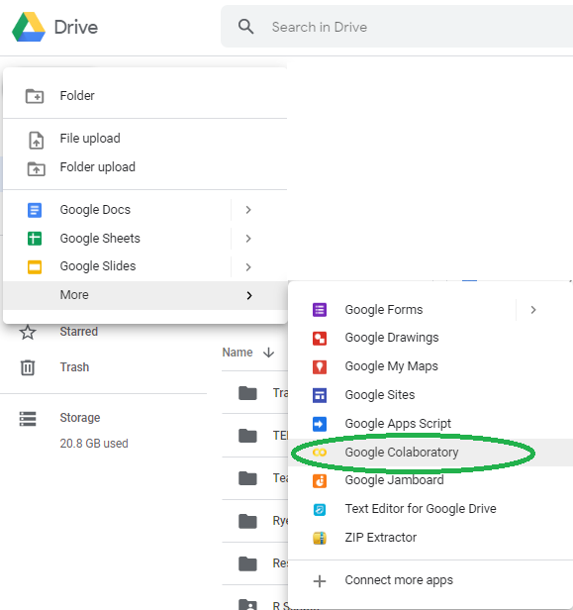
(B) Review of IDE (Virtual)

Slide 10

(C) Review of Machine Learning
“Machine learning (ML) is the study of computer algorithms that improve automatically through experience and by the use of data” – Wikipedia
Ask a question that might be answered with data (as a hypothesis)
Extract the data & understand it automatically
Create decisions or insight, from a computer, that would typically require a human

Slide 11
(C) Review of Machine Learning
What question are we trying to answer?
Write a program that can scan an image and differentiate between a boy and a girl; without a model, program will be super lengthy
If someone asks to now detect other objects in the same picture as well; without a model, it will take forever to incorporate changes
How to solve the problem? In simple words..
Build a model that looks at data, predicts using lots of data
The more input data the more accuracy of your model
Applications of Machine Learning
Robotics/Process Automation
Language Processing
Vision Processing
Stock Market Trends

Slide 12
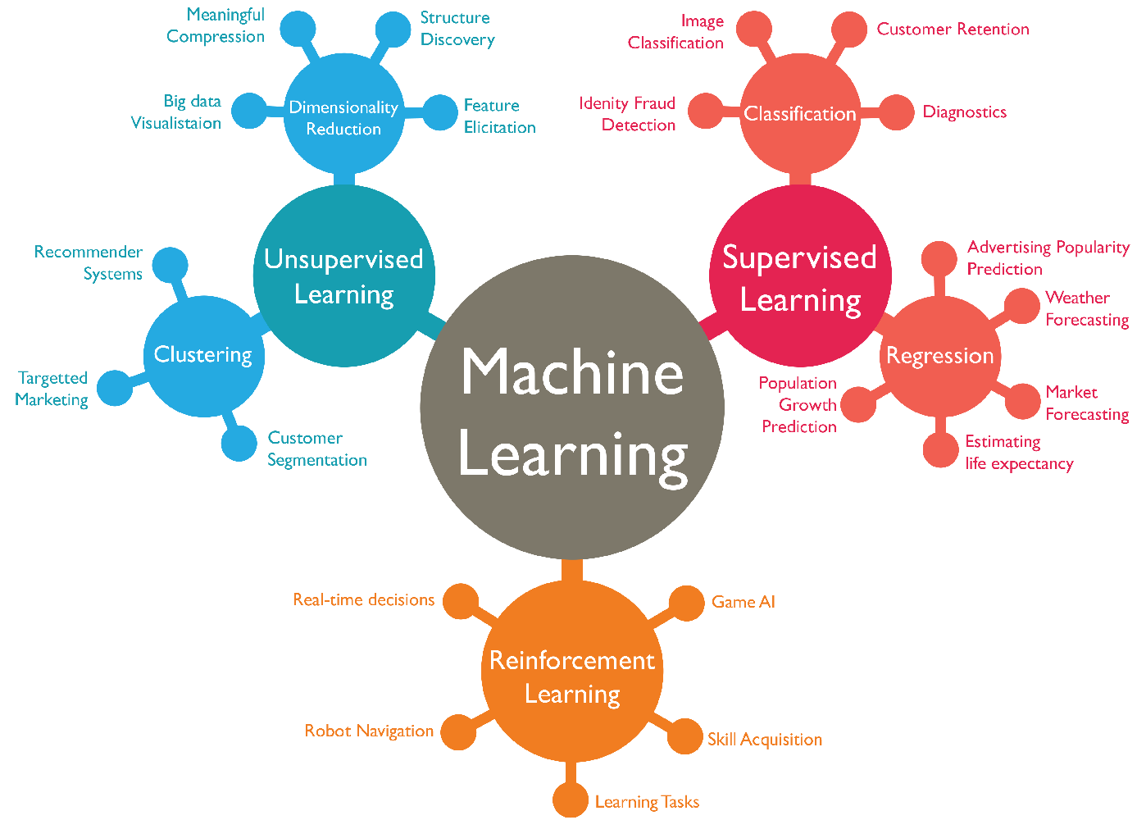
(C) Review of Machine Learning (Overall)
https://wordstream-files-prod.s3.amazonaws.com/s3fs-public/styles/simple_image/public/images/machine-learning1.png?SnePeroHk5B9yZaLY7peFkULrfW8Gtaf&itok=yjEJbEKD

Slide 13

(C) Review of Machine Learning (Steps)
1
“Import” the dataset
Dataset can be from Modules, DB, EXCEL, CSV etc
“Clean” the dataset
Remove duplicates, noise, irrelevant, incomplete, or convert properly
“Approach” the dataset with an “Estimator/Data Strategy” (dependent on objective)
Choose an approach category: Supervised Learning vs Unsupervised Learning
Apply a data strategy by splitting the data into sets
Training Set – to train model (determine a split; 80%)
Test Set – to test the model (determine a split; 20%)
“Analyze” the dataset through an “Model/Algorithm”
Select an estimator’s model/algorithm that can analyze your dataset
Many algorithms/models exist; i.e: Decision Trees, Neural Net etc.
Libraries/Modules can facilitate algorithm/model selection e.g: SciKit-Learn
“Train” your Model to find “Patterns”
Model will look for patterns in the dataset
“Test” your Model to make “Predictions”
Ask Model to answer your question about differentiating between a car and a motorcycle
Predictions are not always accurate
“Measure” accuracy of “Predictions” and “Improve”
Evaluate, measure your accuracy
Go back to predictions, or re-choose a model or fine-tune parameters of the model to optimize accuracy
2
3
4
5
6
7

Slide 14
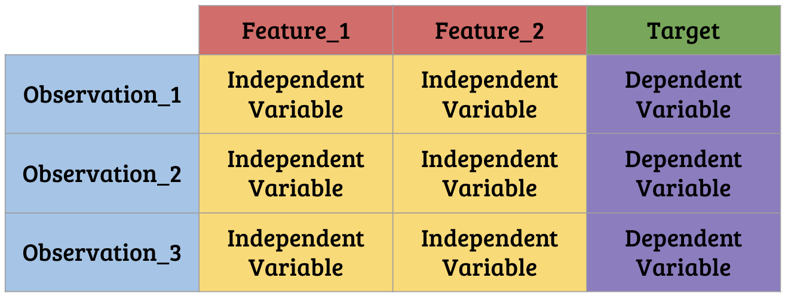
(C) Review of Machine Learning (Terms)
Each row in your data will be known as “observation”
Aka: Sample, example, instance, record
Each column in your data will be known as a “feature”
Aka: input, predictor, attribute, regressor, covariate, data, independent variable
Feature-names are column-headers
Each value in your data that we will be predicting is known as a “response”
Aka: target, outcome, output, label, dependent variable
Knowing your ‘response’ variable is key to understanding which model to use; classification or regression etc.
https://miro.medium.com/max/3000/1*gDF_bo9keqJnKskiEMGHyg.png

Slide 15

(C) Review of Machine Learning (Toolkit)
You should be aware of the following modules in this course:
Pandas
NumPy
Matplotlib
Scikit-learn; Keras/TensorFlow

Slide 16
Disclaimer
Due to nature of the course, various materials have been compiled from different open source resources with some moderation.
The course designer (slides creator), sincerely acknowledges their hard work and contribution, credit will be given wherever necessary

Slide 17
Thank You Very Much
Any Questions?

